Slide 1
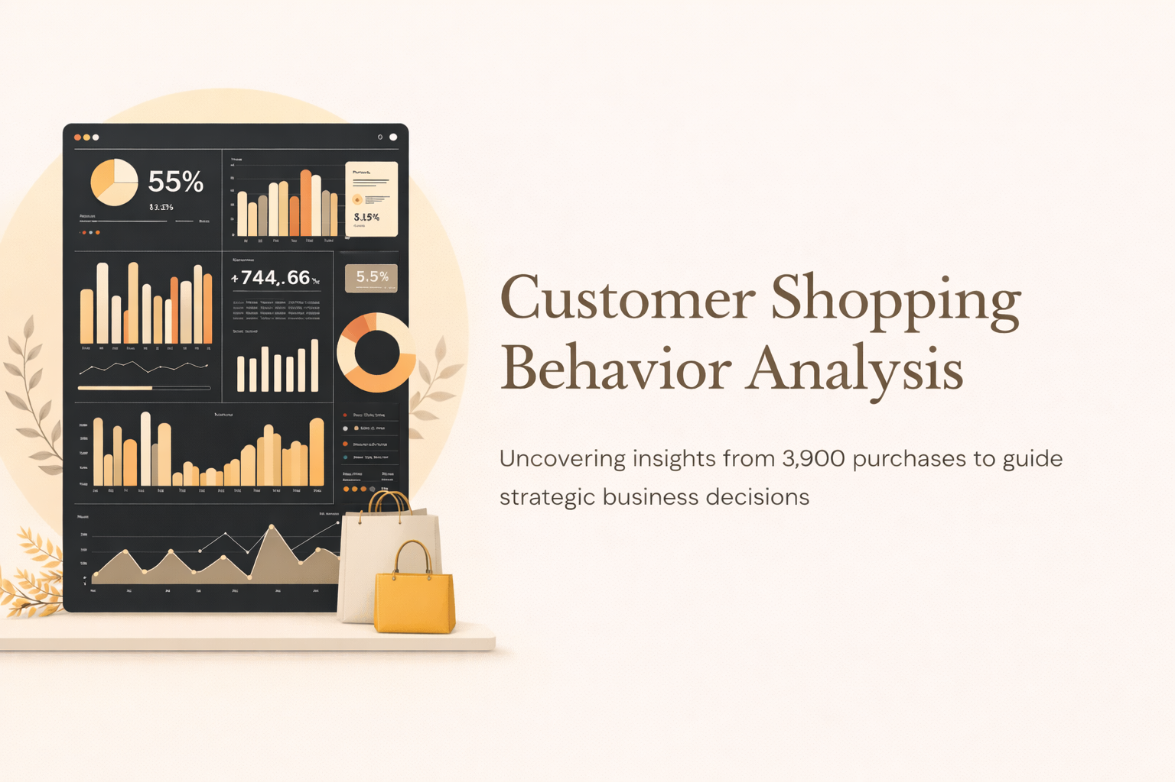

Slide 2
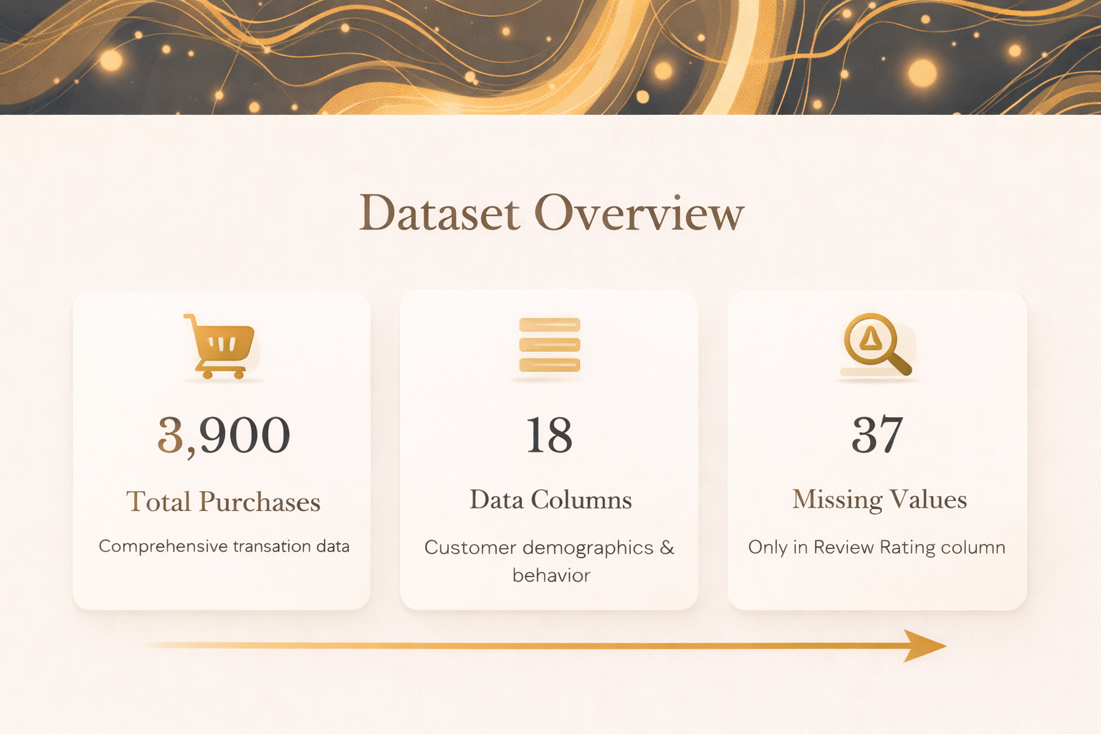

Slide 3
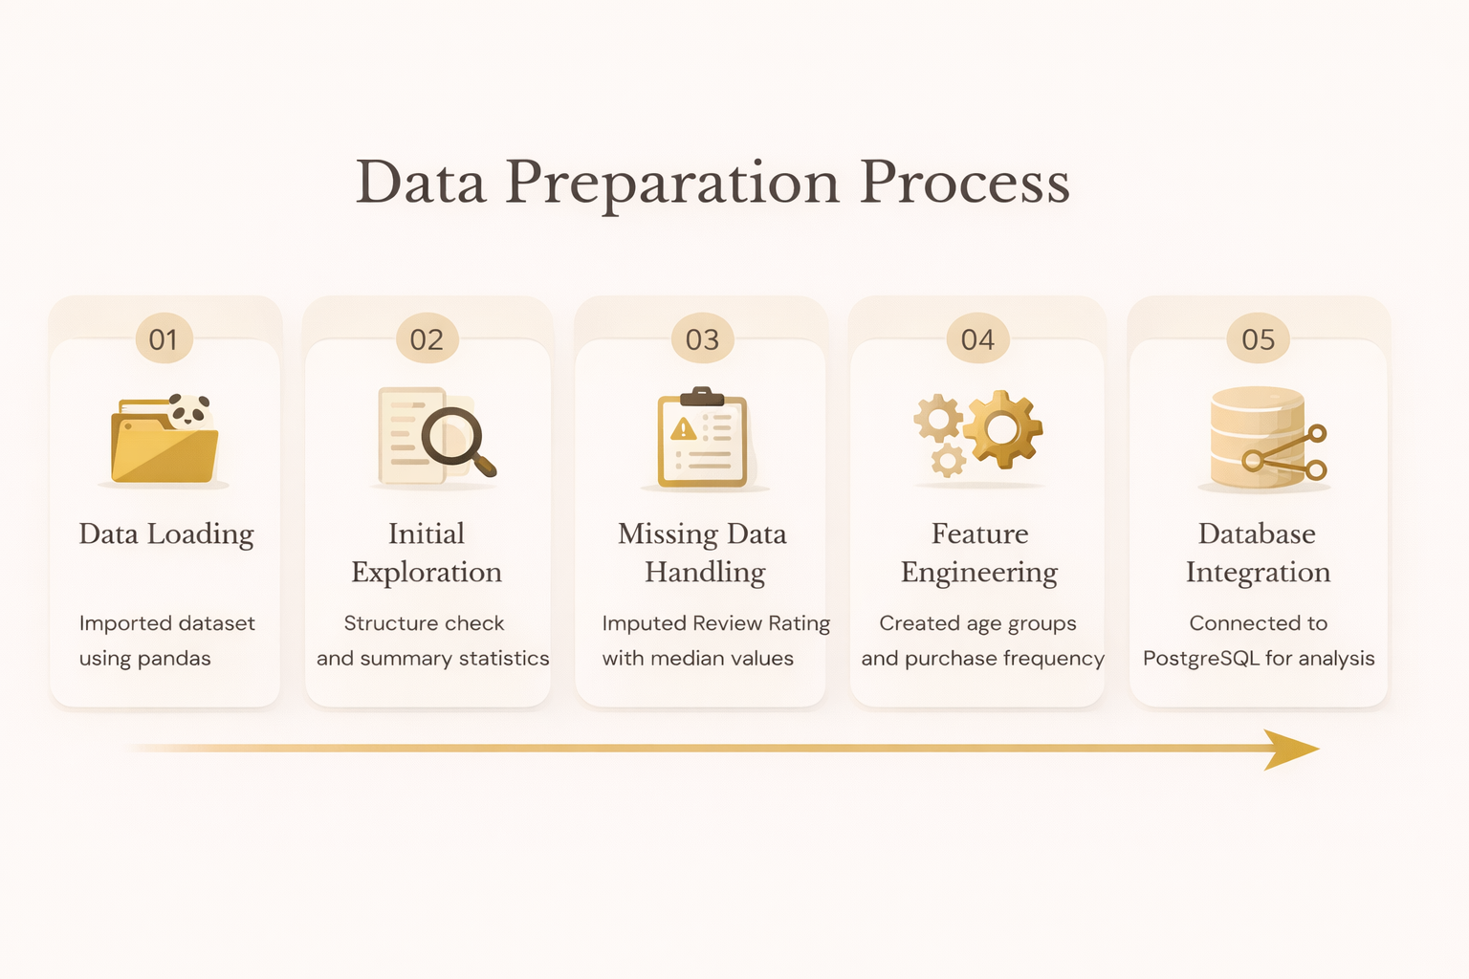

Slide 4
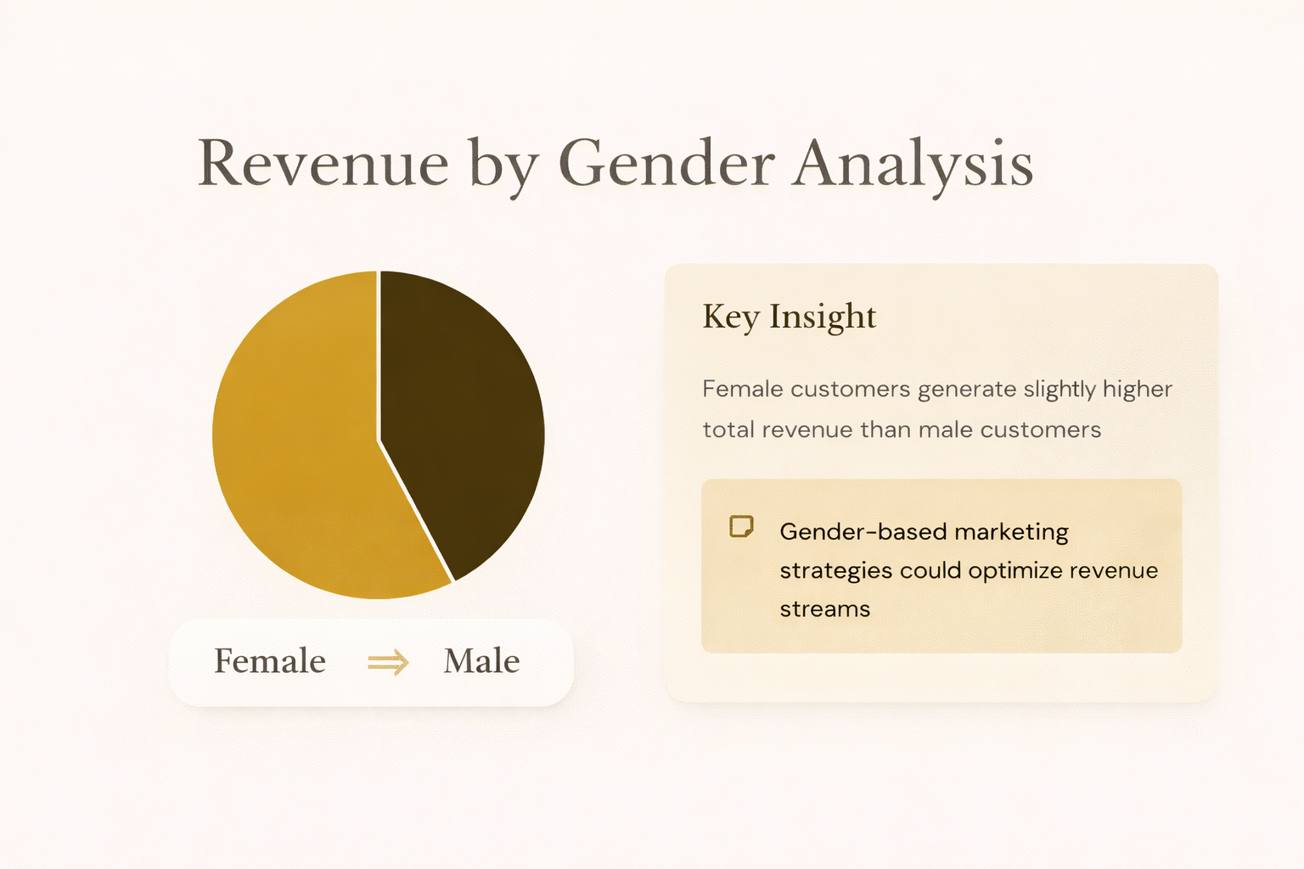

Slide 5


Slide 6
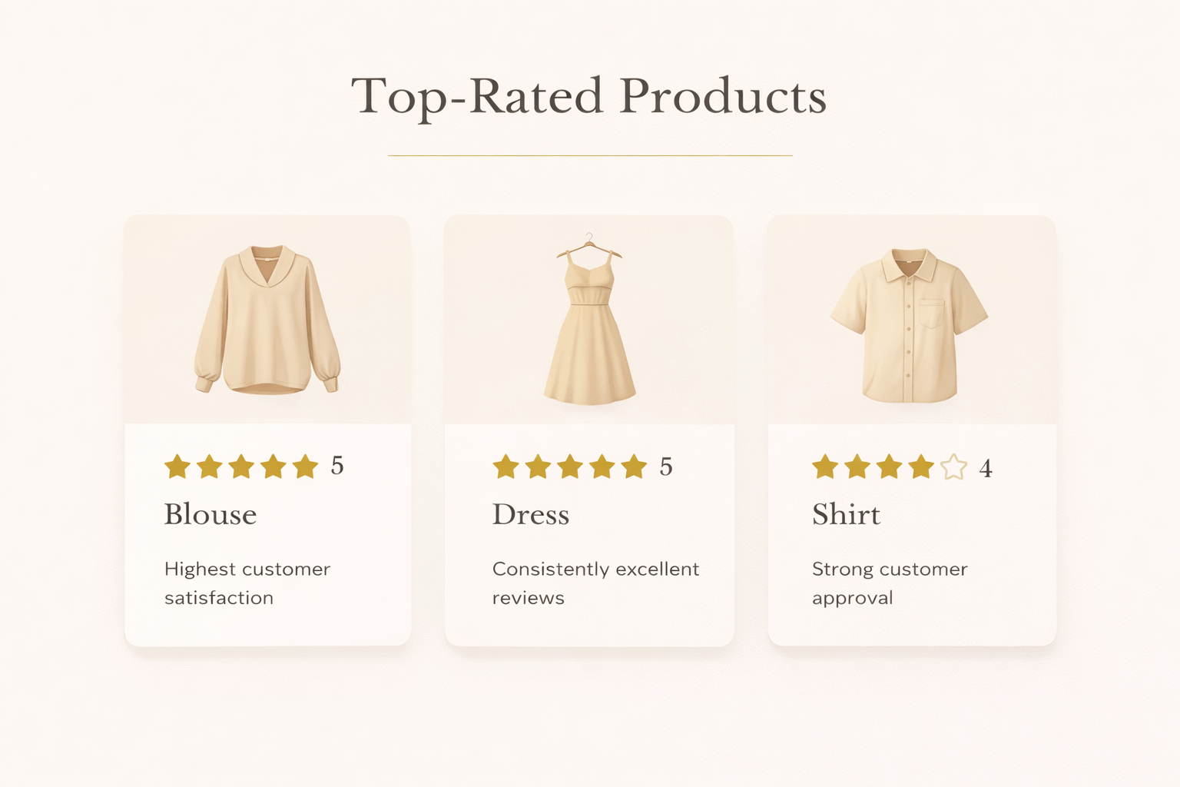

Slide 7
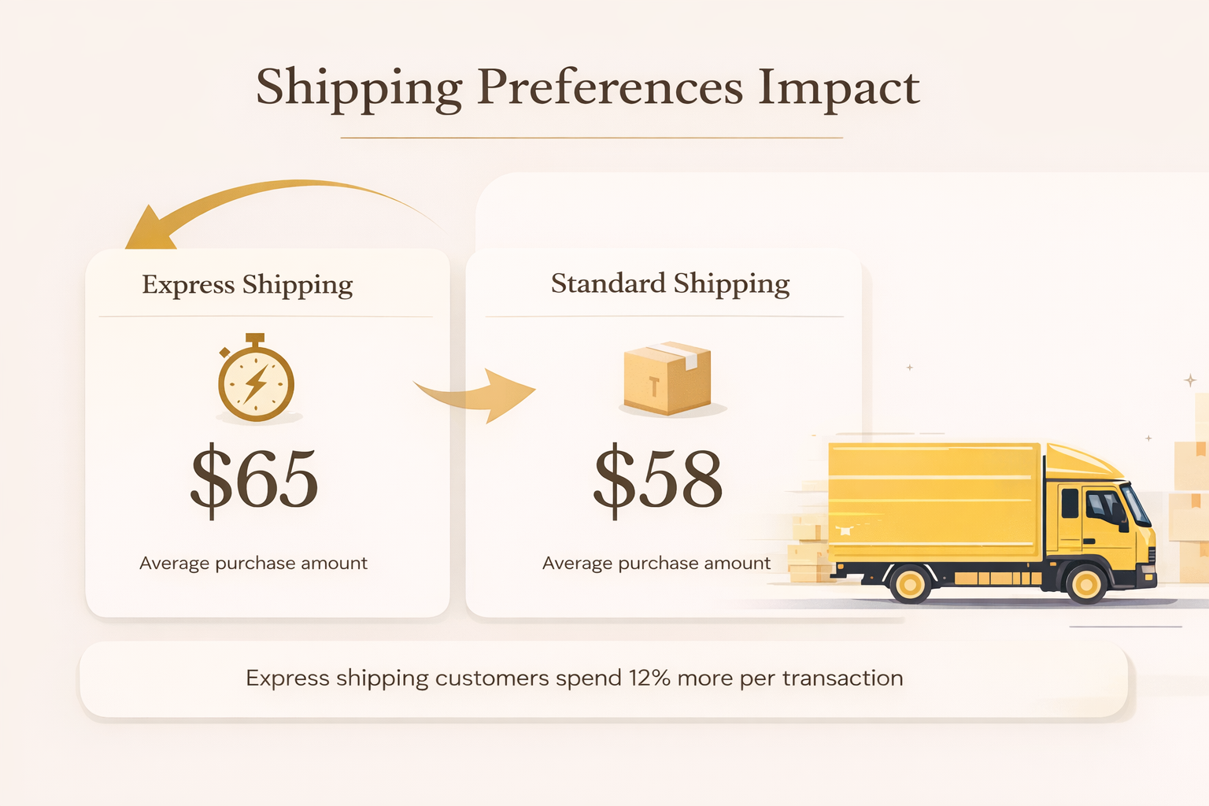

Slide 8
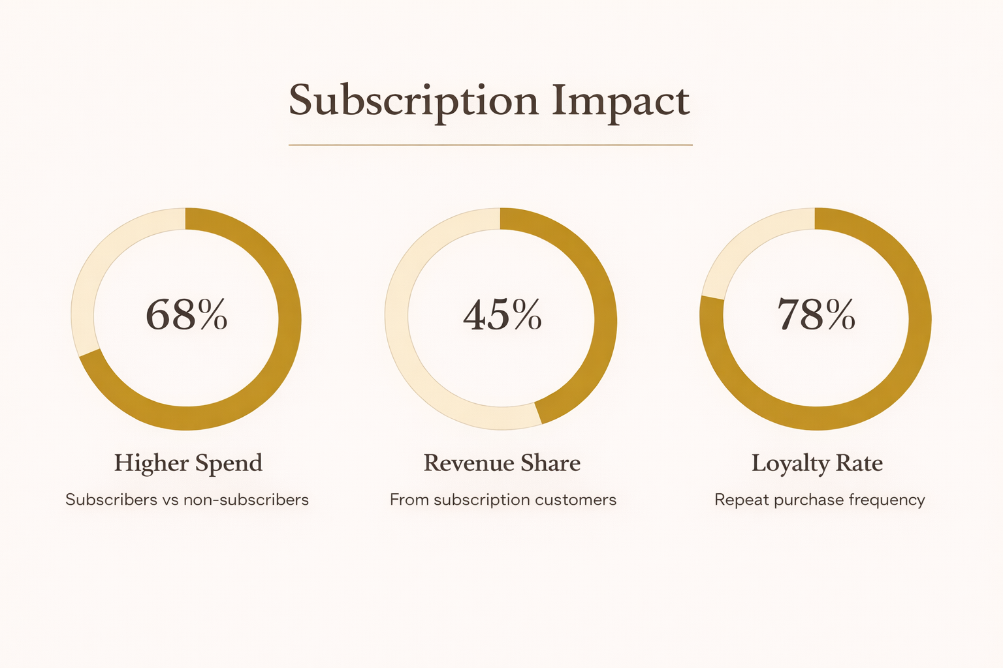

Slide 9
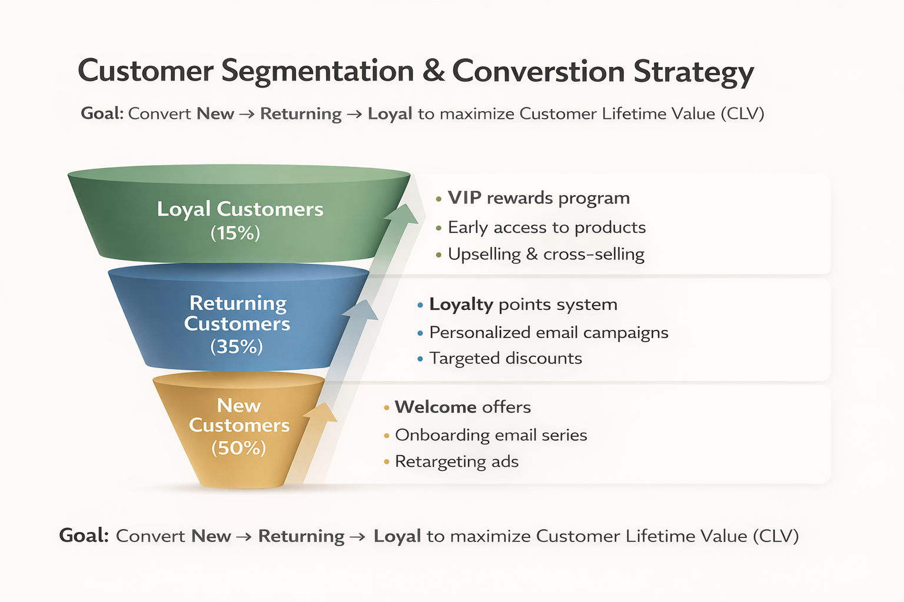



Customer Segmentation
Loyal
1
15% - High value customers
Returning
2
35% - Regular shoppers
New
3
50% - First-time buyers
Focus on converting New to Returning, Returning to Loyal

Slide 10
